Slide 1
Calculus: Single Variable

Slide 2
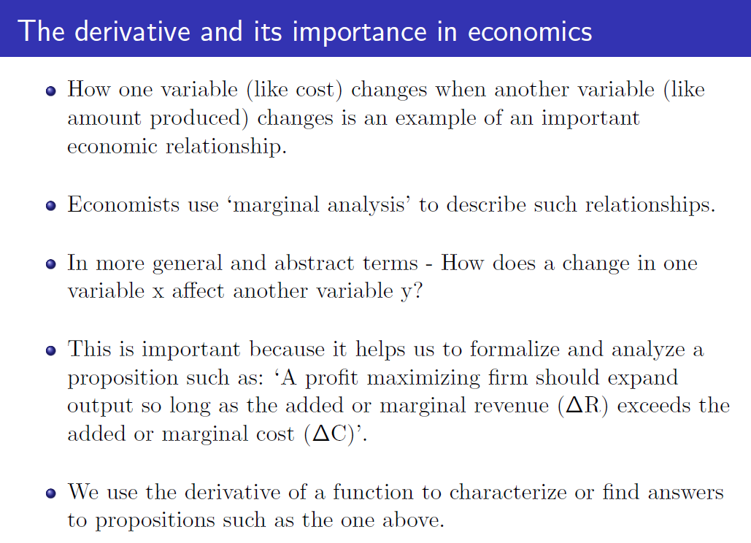

Slide 4
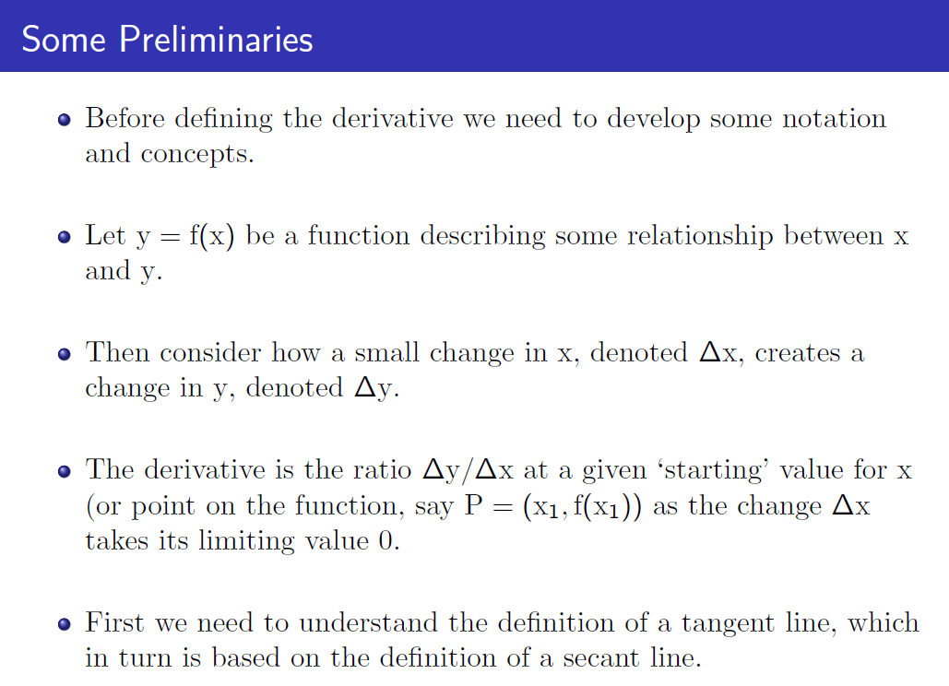

Slide 6
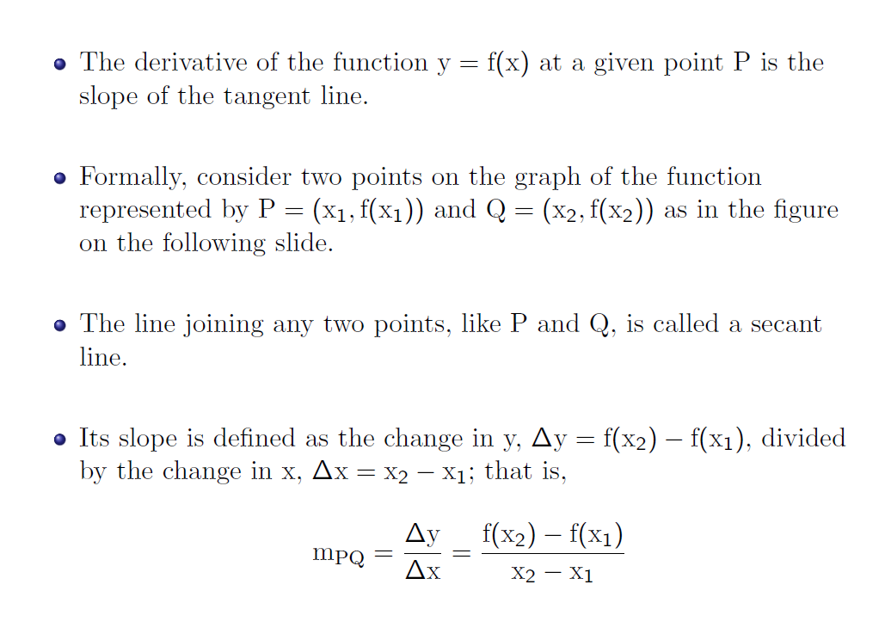

Slide 7
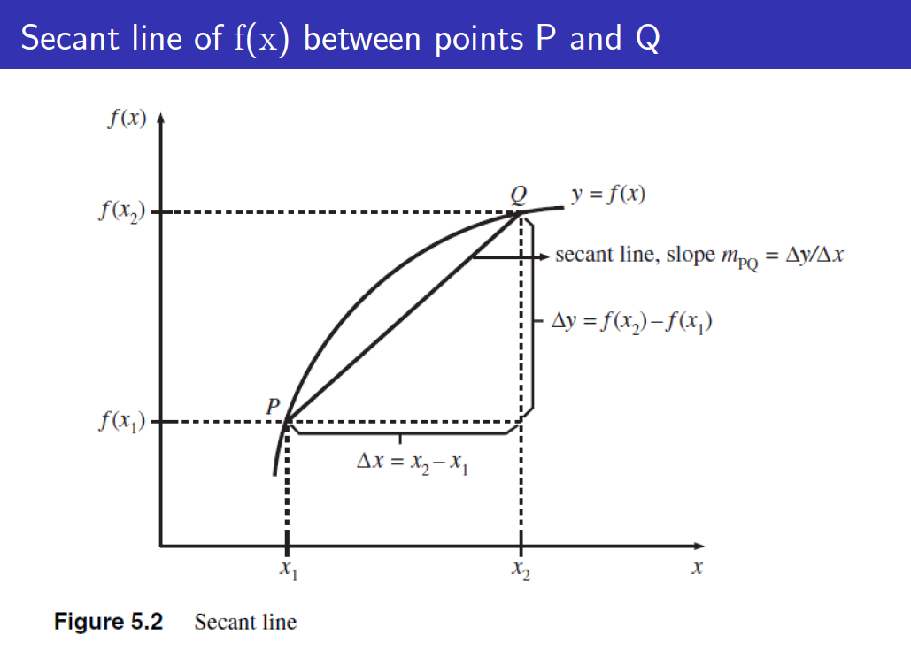

Slide 9
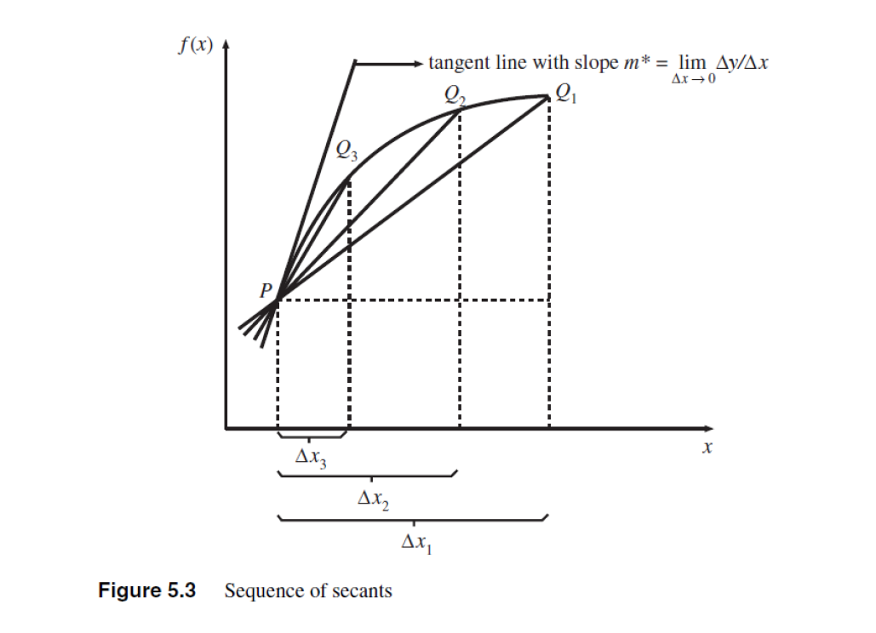

Slide 10
dy/dx =
Lt f(Xo + ΔX) – f(Xo)
ΔX ➔0 ΔX
ΔX = X - Xo

Slide 11
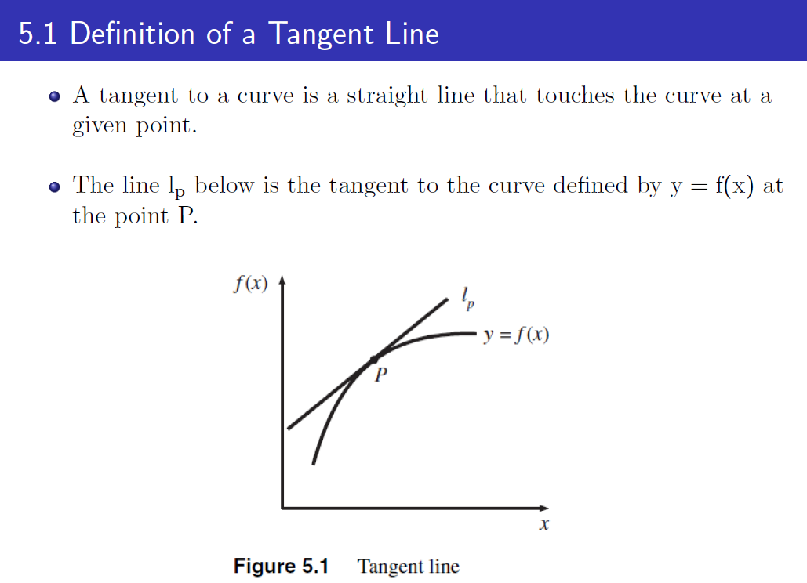

Slide 12
Examples
Using the definition of the derivative above, find the derivative of the following functions at Xo = 5:
f(x) = 20
f(x) = 3x + 5
f(x) = 2X² - 4x +5

Slide 13
f(x) = 3x + 5
f(x) = 2X² - 4x +5

Slide 14
Suppose the inverse demand for a product is given by P = 100 – 3Q
TR =
Using a derivative, MR =
Construct the demand curve and the MR curve. Compare the intercept and slopes of the two curves. Briefly explain why the MR curve lies below te demand curve

Slide 17
Rules of Differentiation
1. Derivative of a constant is zero.
d(k)/dx = 0
2. Derivative of the product of a constant and a function is the product of the constant and the derivative of the function
d(kg(x))/dx = k d(g(x))/dx

Slide 18
3. Derivative of the sum (difference) of polynomial functions is the sum (difference) of the derivatives of the components on the function
If f(x) = g(x) + h(x) or f(x) = g(x) - h(x)
f’(x) = g’(x) + h’(x) f’(x) = g’(x) – h’(x)

Slide 19
Differential: dy
Previously we saw for a secant line:
Δy = slope of secant line * ΔX
We can think of dx as the ΔX (small change in x from Xo, and dy as an approximation to the resulting change in y, Δy.
dy = slope of the tangent line at Xo * dx
dy = f’(Xo) dx

Slide 20
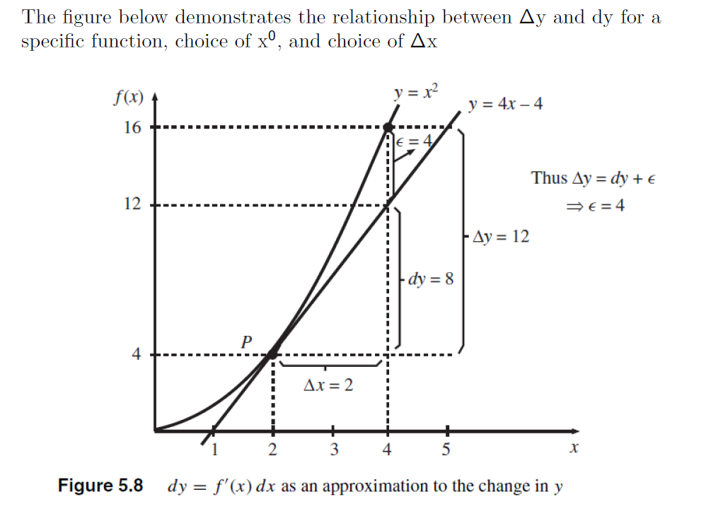

Slide 21
Find dy at Xo = 3 when f(x) = 3x² + 2

Slide 22
Good approximation for small changes in X.

Slide 23
Derivative of X^{n}
Δy/Δx = [(x_{o} + Δx)^{n} – x_{o}^{n} ]/Δx
Let us just look at the numerator [(x_{o} + Δx)^{n} – x_{o}^{n} ] and the first term
(x_{o} + Δx)^{n} = x_{o}^{n} + (^{n}C₁) x_{o}^{n-1} Δx_{o}+ (^{n}C₂)x_{o}^{n-2} Δx_{o}²+ ……. + Δx_{o}^{n}
(x_{o} + Δx)^{n} – x_{o}^{n} = (^{n}C₁) x_{o}^{n-1} Δx_{o}+ (^{n}C₂)x_{o}^{n-2} Δx_{o}²+ ……. + (..) Δx_{o}^{n-1}

Slide 25
[(x_{o} + Δx)^{n} – x_{o}^{n} ]/Δx = (^{n}C₁) x_{o}^{n-1} + (^{n}C₂)x_{o}^{n-1} Δx_{o}²+ ……. + (..) Δx_{o}^{n-2}
Take the limit as Δx ➔ 0 = n x_{o}^{n-1}
So, if y = f(x) = X^{n}, then dy/dx = f’(x) = nX^{n-1}
It’s differential is
dy = f’(x) dx

Slide 26
Examples: Find f’(x) when
f(x) = 3x⁴ + 5x² – 7x + 2
F(x) = 5x³ - 2/x + sqrt(x)

Slide 27
Additional Rules of Differentiation: Product Rule
4. If f(x) = g(x)*h(x), then f’(x_{o}) = h(x_{o})g’(x_{o}) + g(x_{o})h’(x_{o})
Suppose f(x) = (3x³ + 2X² + 1/x)(5x + 4)
Then, f’(x) =

Slide 28
Quotient Rule
5. If f(x) = g(x)/h(x)
f’(x) = [h(x)g’(x) – g(x)h’(x)]/(h(x))²
Suppose, f(x) = (3x² + 5x)/(4x + 2). Then f’(x) = ?

Slide 30
Suppose TC = C(Q) and MC = C’(Q)
AC(Q) = C(Q)/Q
d(AC)/dQ = [QC’(Q) – C(Q)]/Q² = (1/Q)[C’(Q) – C(Q)/Q]= (1/Q)(MC-AC)
d(AC)/dQ > 0 if MC > AC and Vice Versa

Slide 32
